Slide 1

Notes:
Today we are continuing Part 2 of our Sermon on the Mount series. In the Sermon on the Mount, Jesus proclaims the good news of the Kingdom of God and casts a vision of what it looks like to live in right relationship with God, our neighbors, and our enemies. These three chapters (Matthew 5-7) contain the core of Jesus’ teachings and his most well-known sayings, including some of the most rigorous ethical demands in the Bible, as we’ve seen already in this series.
And while interpretation and conversation are necessary, Jesus intended his followers to put his words into practice as individuals and as a faith community, bearing witness to who he is and to the gospel of God’s coming Kingdom. Therefore, as I’ve said before, what Jesus has given us in the Sermon on the Mount is not “pie in the sky when you die” for the sweet by-and-by. No, the teachings of Jesus and his invitation to follow him are for this world. And while the gate is small and the road is narrow… it leads to life.
So, let’s remember that Jesus is calling us to a “greater righteousness”… [NEXT SLIDE]

Slide 2
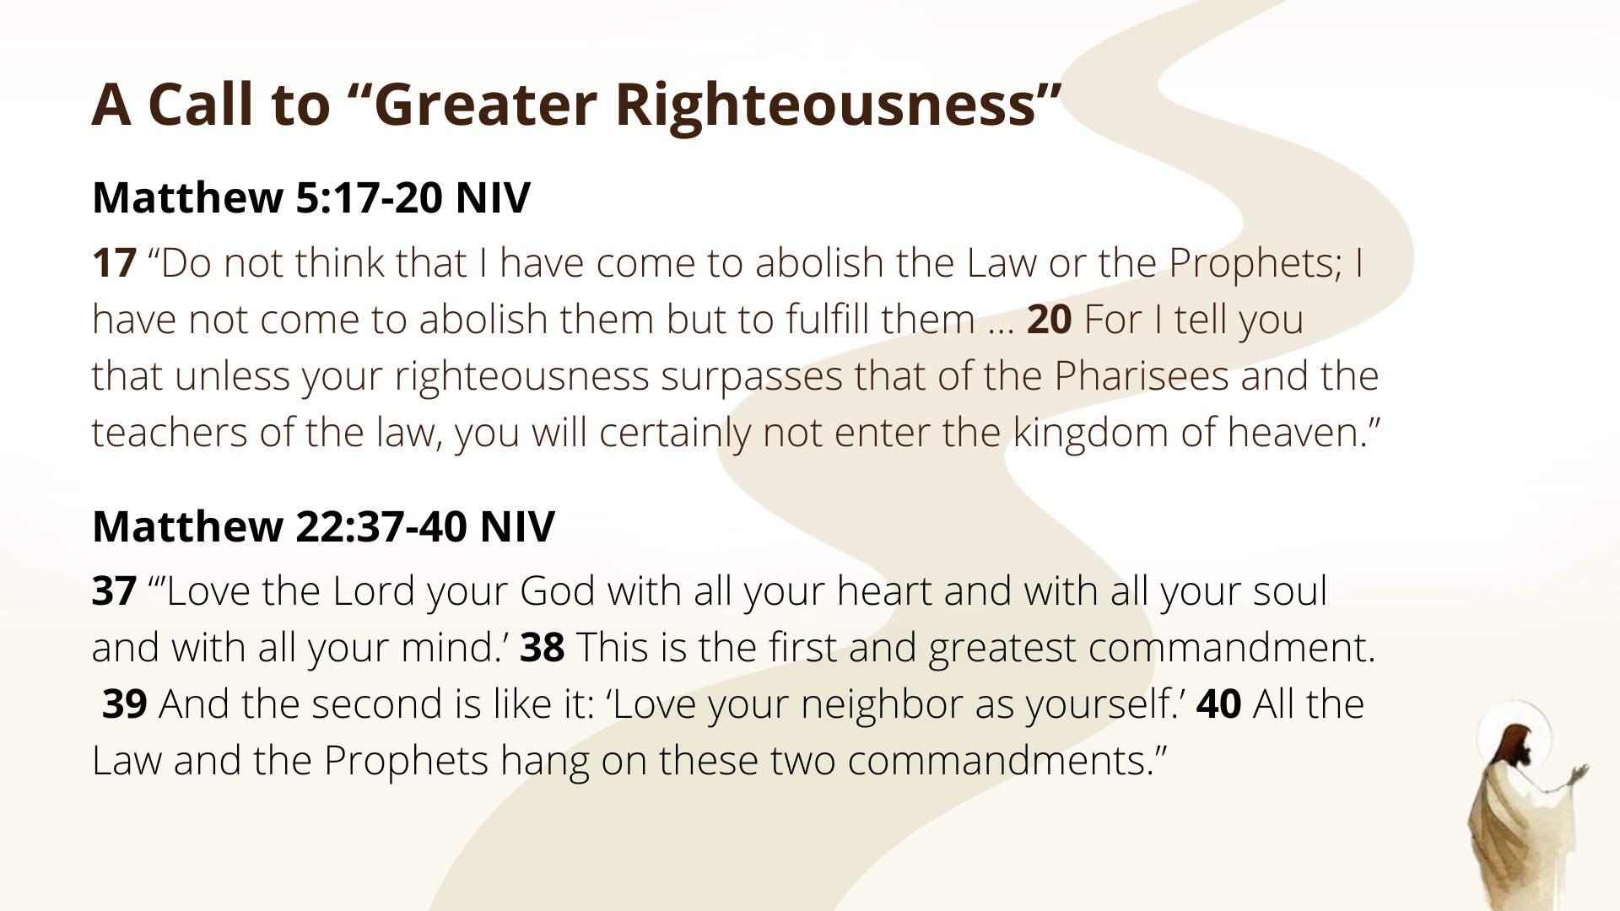
Notes:
Jesus said that he didn’t come to do away with the Law or the Prophets (the Old Testament), he came to reveal their true intent, which can be summed up in loving God and neighbor. Therefore, Jesus shows us what God is like and what God desires for his people who are made in his image. And then he invites us to come into his Kingdom where we choose to partner with God in becoming like Christ and bringing heaven to earth.
To help us see where today’s message fits within the whole of the Sermon on the Mount, check out this image we’ve been using from the BibleProject… [NEXT SLIDE]

Slide 3
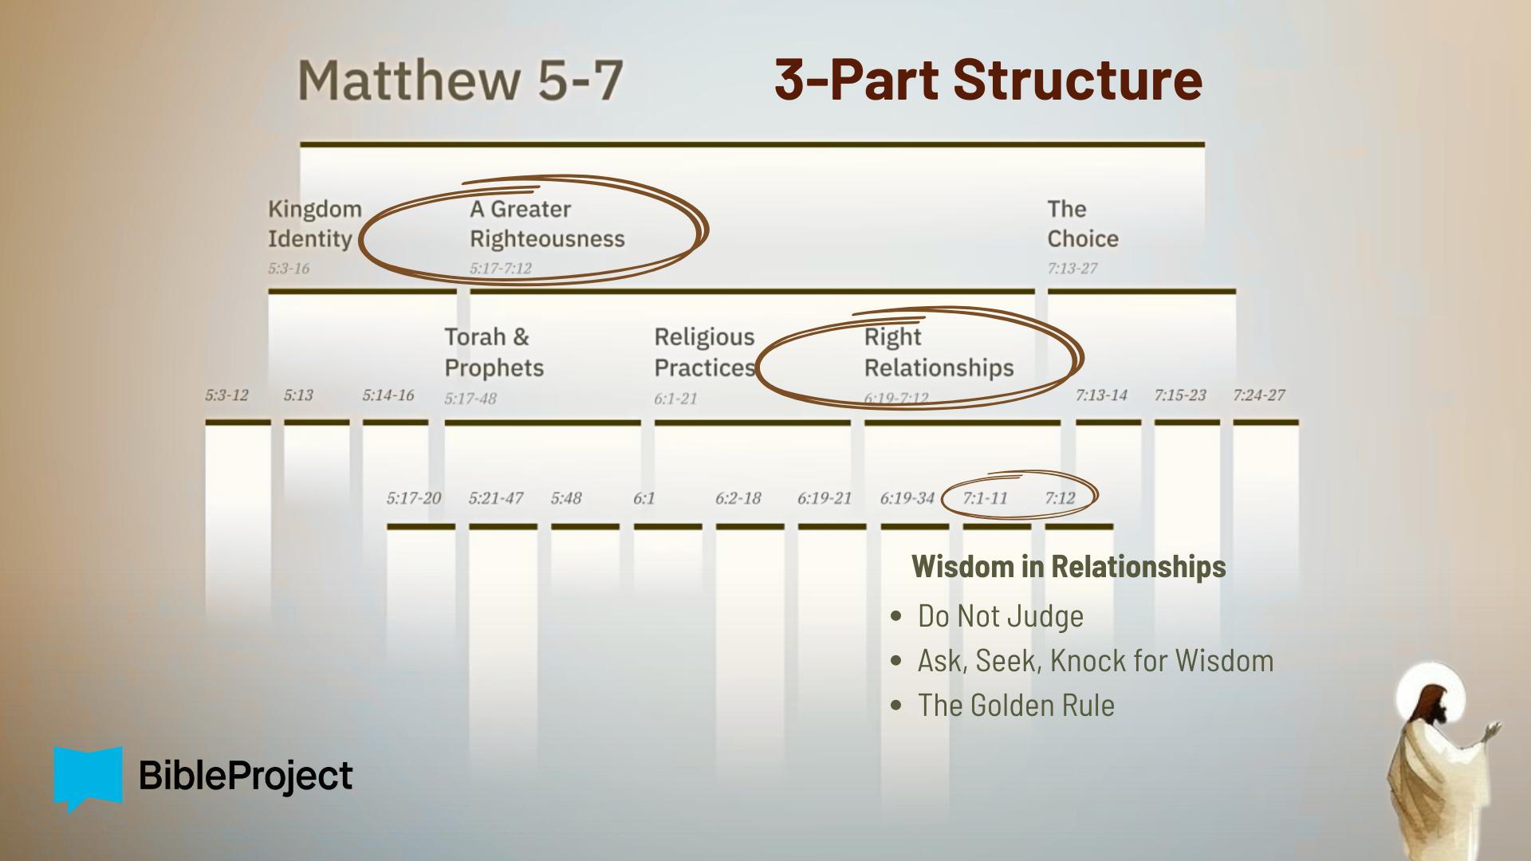
Notes:
Once again, there is a 3-part repeated structure to the sermon. It contains 3 major sections, and the middle section (main body) itself has 3 parts, and each middle part breaks into 3 parts, as well. If you look at the top (Kingdom Identity), we have an opening description of those who are being invited into his Kingdom and the sort of folks that God blesses—those who will experience the good life.
Then the main body of the sermon (A Greater Righteousness), which describes what it looks like to live in right-relationship with God, our neighbors, and our enemies. Within the main body, Jesus gives examples of how to apply OT laws, how religious practices can orient our hearts to God and be life-giving, and then how we ought to relate to money and people. And we’re going to wrap up the main body this morning with Jesus’ final words about relating to God as a good Father, seeking his wisdom, and treating others the way we want to be treated. Finally, the next two Sundays we will cover Jesus’ conclusion (the Choice), where he invites us (his listeners) to choose how we will respond. I hope you will join us for an epic finish to the series.
If you’re taking notes, I’ve entitled today’s message… [NEXT SLIDE]

Slide 4

Notes:
Wisdom in Relationships. Please join me in praying before we begin.
Father, may the words of my mouth and the meditation of my heart be acceptable in your sight, O LORD, my Rock and my Redeemer. We give this time of “Hearing the Word” to you. We ask that you speak words of comfort, of conviction, of challenge, and of assurance. Free us from our bondage. Remove the scales from our eyes. We pray against our real enemy who seeks to steal, kill, and destroy, and blind the minds of unbelievers. Jesus, illuminate our hearts and minds with your light. Holy Spirit, help us to receive the words of God and empower us to live according to the decrees of heaven. In the name of Christ, we pray. Amen.
Would you open your Bibles to our main Scripture reading… [NEXT SLIDE]

Slide 5
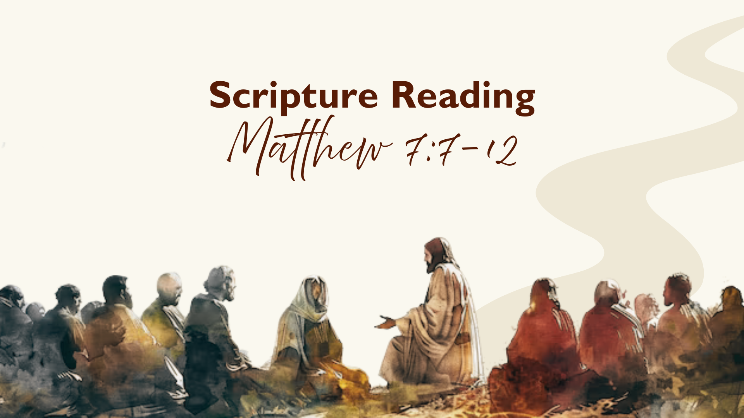
Notes:
Matthew 7:7-12. [INVITATION TO STAND FOR SCRIPTURE READING]
[READ SCRIPTURE] This is the word of the Lord. Thanks be to God. You may be seated.
A man once told his pastor that he had prayed for years for God to change his difficult coworker. Every morning, he asked God to fix the situation — to make the person kinder, easier, or maybe even move them somewhere else. Years later, the man realized something surprising had happened. The coworker hadn’t changed much — but he had. He was more patient, less reactive, slower to assume the worst. What God gave him wasn’t the situation he asked for, but the wisdom he needed to live faithfully within it.
And that’s what Jesus is inviting us to ask, seek, and knock for at the end of this section on living in right relationship with others: for wisdom. Which is why these words aren’t found back with Jesus’ previous teaching on prayer in Matthew 6. The prayer he is referring to here is specifically for wisdom to know how to live and apply his teachings. Real quick… let’s go verse-by-verse and unpack this a bit… [NEXT SLIDE]

Slide 6
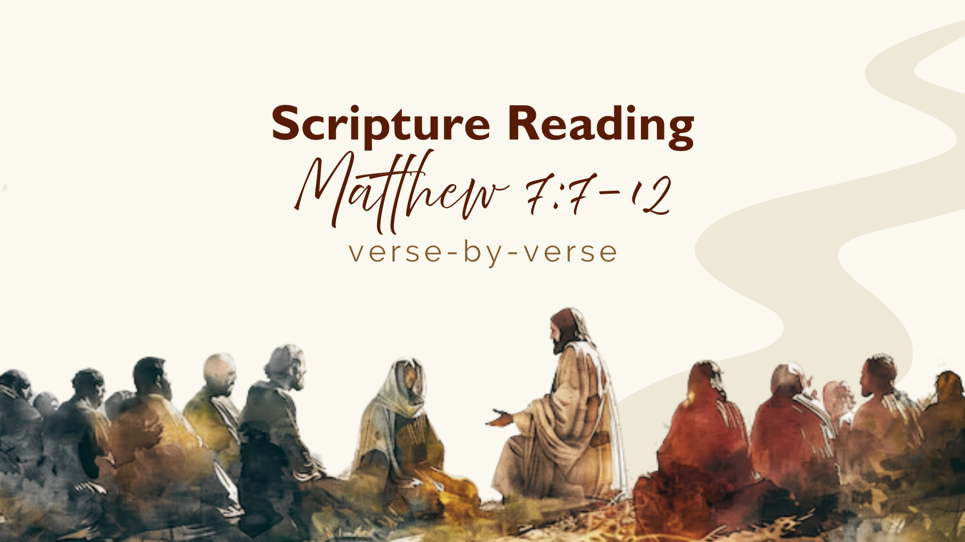
Notes:
[READ VERSE-BY-VERSE & COMMENT]
v. 7 – “ask, seek, knock” – notice the progression: ask, seek, knock. There is intentionality involved. This isn’t about God playing hide and go seek from you. This is getting at the longings and deepest desires of your heart. Do you truly love God? Do you want to know his will? Do you want to acquire his wisdom in how he’s calling you to live, e.g., with your money, with your anxieties, with your view of others (not judging), etc.? v. 8 – “asks… receives; seeks… finds; knocks… the door opened” - this is not a magic formula or incantation. This isn’t, “Lord, I really want that big house and luxury vehicle.” No, Jesus, as he said in Matt 6:33, is talking about seeking the Kingdom; he’s talking about a longing to know God and to walk wisely in this world; to be about spiritual growth, character formation, blessing our neighbors, and embodying the gospel. Because this is the prayer and sort of asking, seeking, and knocking that the Lord happily responds.
So, what are we asking for? Listen to what Tom Wright says… [NEXT SLIDE]

Slide 7
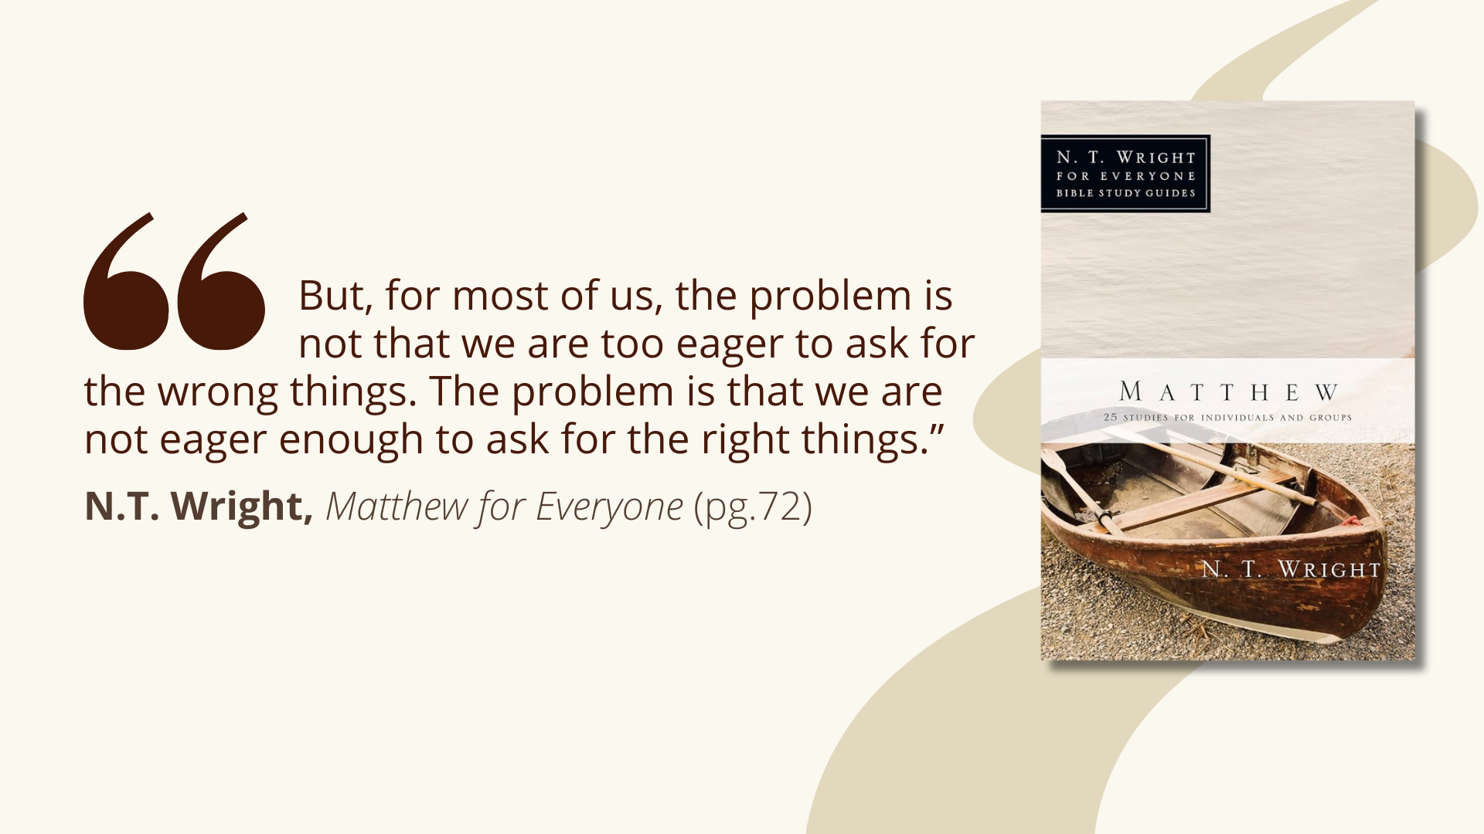
Notes:
[READ QUOTE & COMMENT]
And that’s what I think Jesus is getting at. Do you hunger and thirst for the good life of God? Are you pursuing him and seeking to live in deeper, truer, and more faithful relationships with God and neighbor? Are you using the life he gave you for his glory? If not, there’s still time. And if so, understand that God the Father wants to bless you so that you can be a blessing. Because he is good. He is so very good.
Look at verse 9... [NEXT SLIDE]

Slide 8
Notes:
[READ VERSE-BY-VERSE & COMMENT]
v. 9-10 – What sort of parent would do that?! Asking for bread and fish (which were a basic form of sustenance in first century Palestine), is a reasonable ask from a child. They need those things for life. And so, only in our nightmares would a parent mock and put their child at risk.
v. 11 – Parents are broken, fallen, and full of flaws; but we still know what is good and right. And so, if God, who is holy, pure, and perfect, is sincerely asked, sought after, and has a child walk down the hall to knock on his door, how much more eager do you think he will be to bless his little ones? And how much greater the gifts! You see, Jesus wants us to see the Father the way he sees the Father—the giver of all good gifts.
And then verse 12, which we often refer to as the Golden Rule:
v. 12 - In his commentary on the Sermon on the Mount, Scot McKnight treats the Golden Rule as the climactic summary of Jesus’ ethical teaching and as a kingdom-shaped way of life, not a vague moral slogan. “for this sums up the Law and the Prophets” means the “Golden Rule” is not an add-on or a general proverb. It book ends what Jesus began with when he said, “I didn’t come to abolish… but to fulfill.”
He is telling us that everything should be understood through this interpretive lens: love God, love neighbor, and “do unto others” what you’d have them do unto you. And the Golden Rule is strikingly different that what other teachers of the Law said at that time. The most famous parallel comes from Rabbi Hillel, a revered Jewish teacher just before Jesus.
When asked to summarize the Torah while standing on one foot, Hillel replied: “What is hateful to you, do not do to your neighbor. This is the whole Torah; the rest is commentary.” This is sometimes called the Silver Rule. Because notice, Hillel’s teaching focuses on restraint; it aims only at avoiding harm; and it sets a minimum moral threshold. But what Jesus does in contrast is move from restraint to initiative. He is teaching us to actively seek our neighbor’s good — because that’s how God treats us.
And how do we do this? What does it look like? Well, we’re told by Jesus to go to the Father for wisdom. Listen to what Jesus’ half-brother James wrote in his wisdom epistle… [NEXT SLIDE]

Slide 9
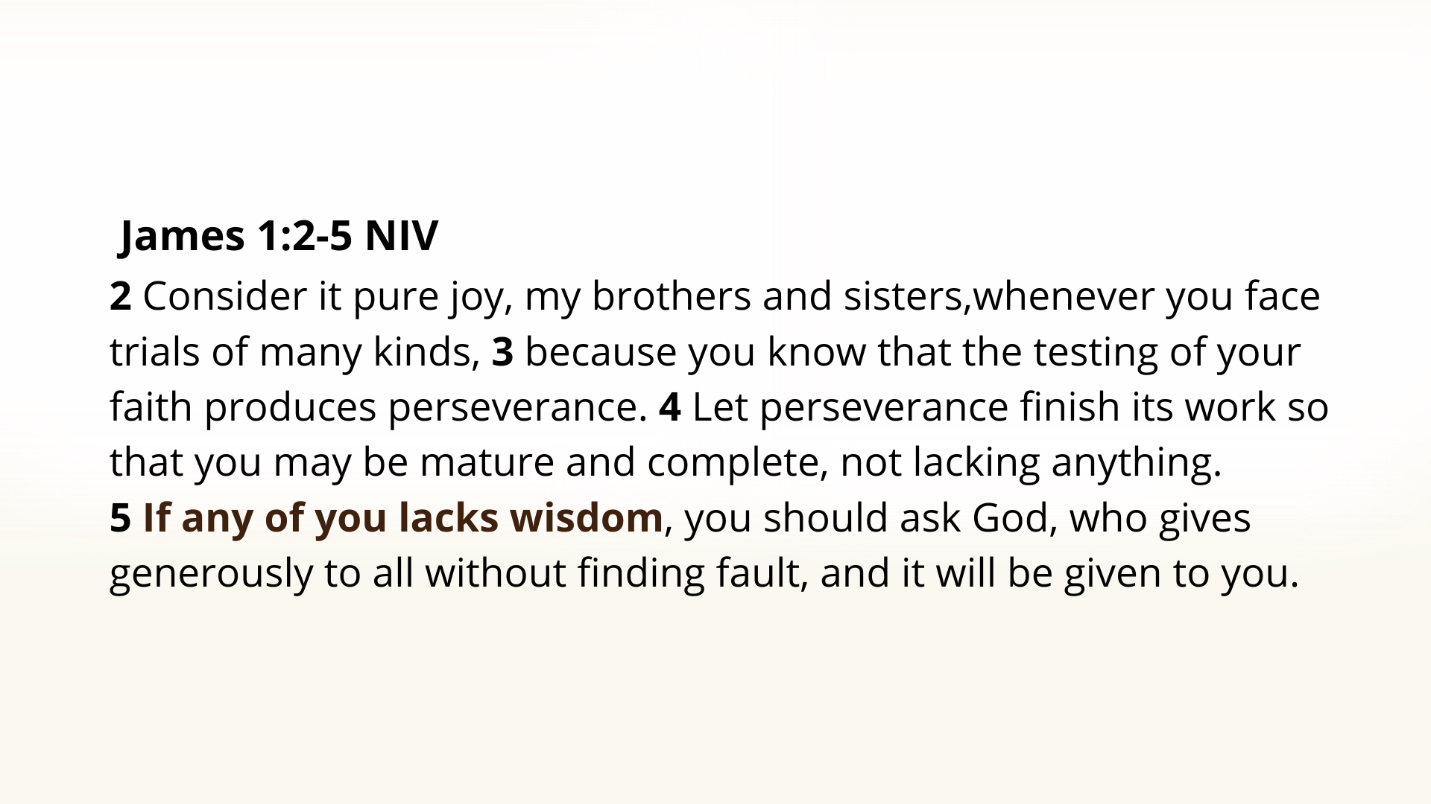
Notes:
[READ & COMMENT]
“it will be given to you” - I’ve found that God delights in granting requests for wisdom (e.g., Solomon)
Can you think of a time when you needed God’s wisdom and he gave it?
[PERSONAL EXAMPLE]
As we begin to land the sermonic plane this morning, here is a summary and three takeaways… [NEXT SLIDE]

Slide 10
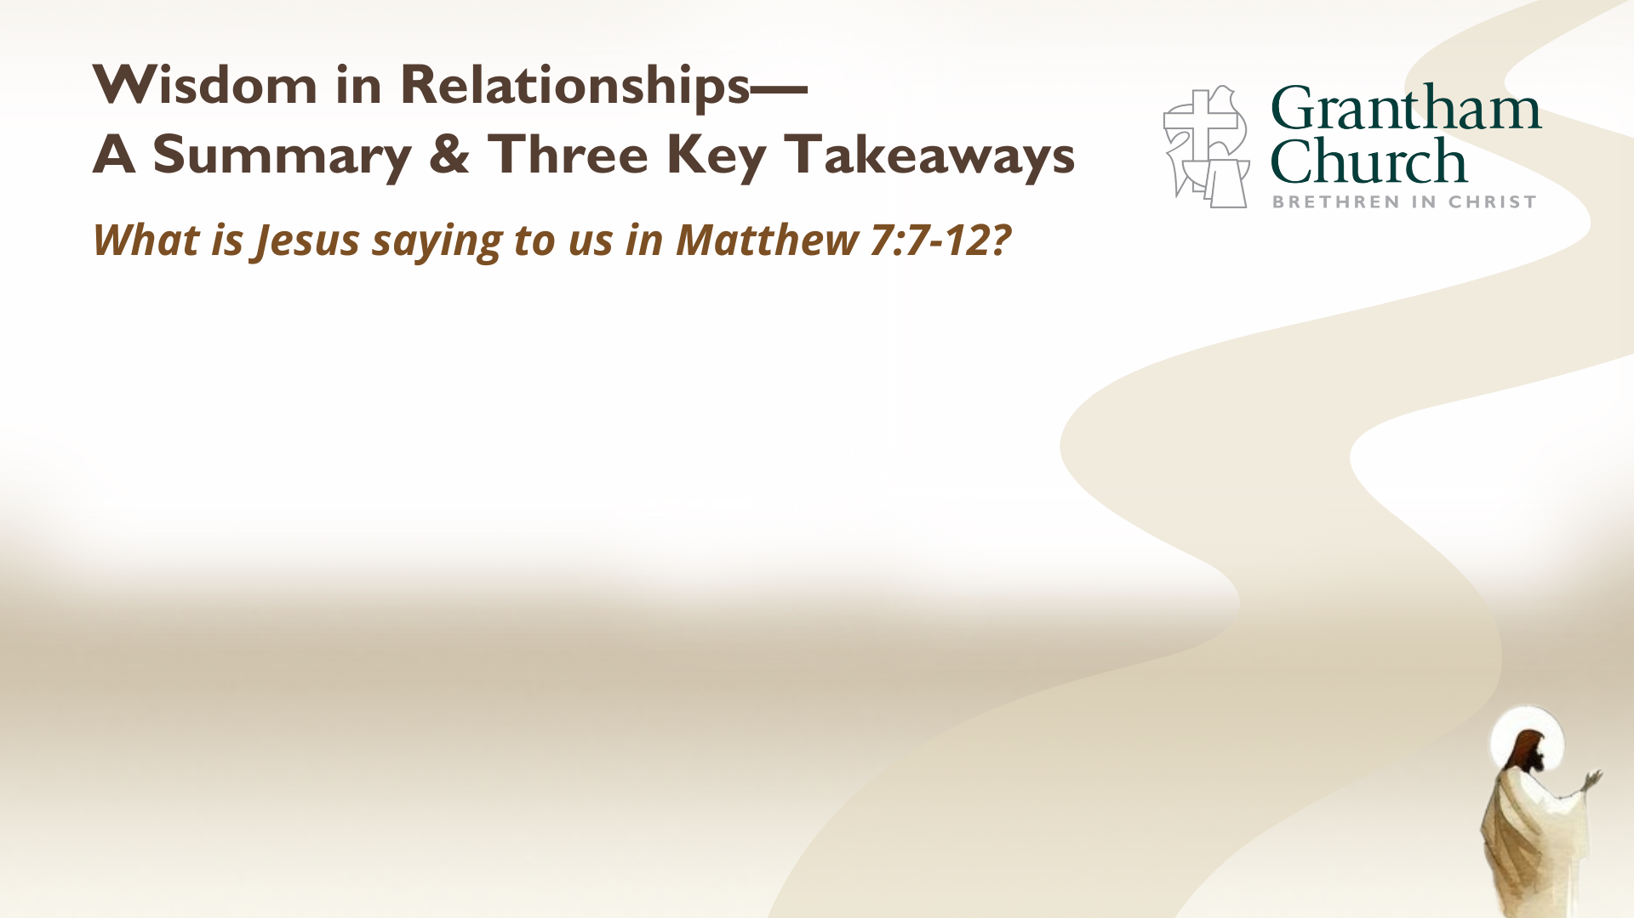

Slide 11
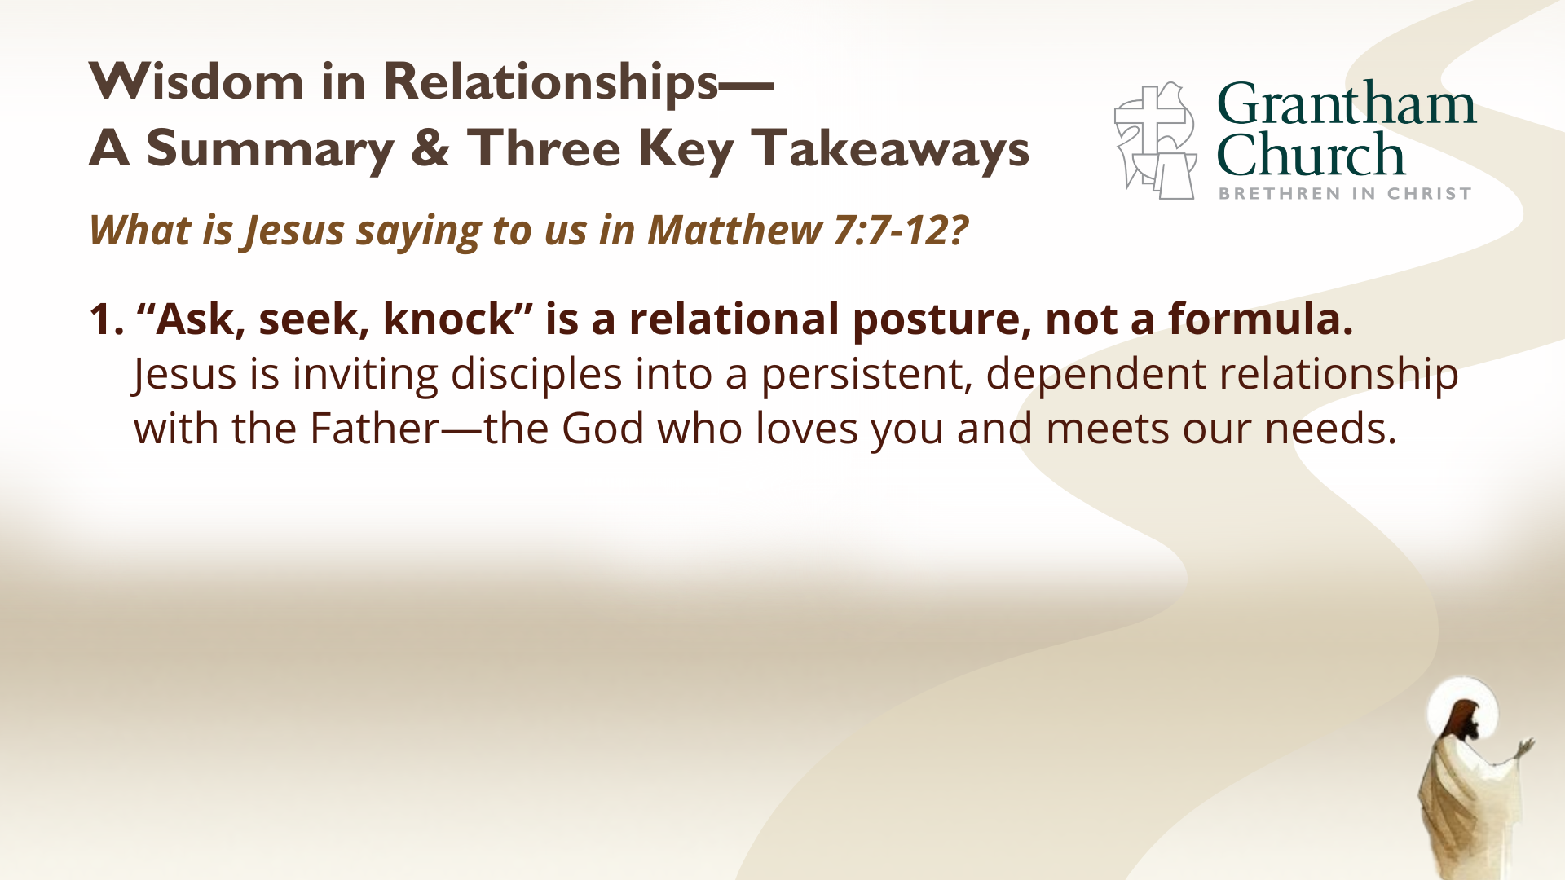

Slide 12
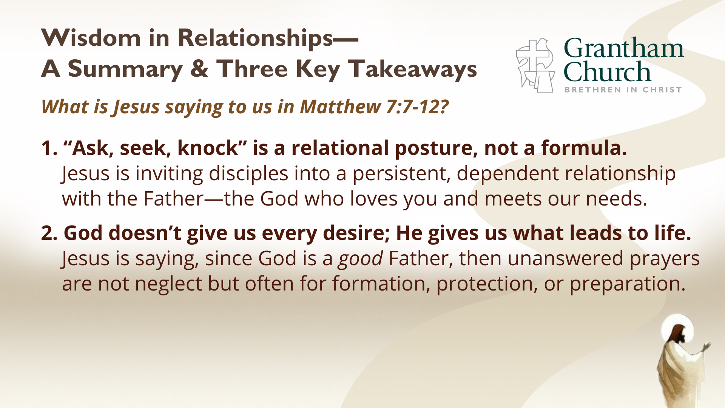

Slide 13
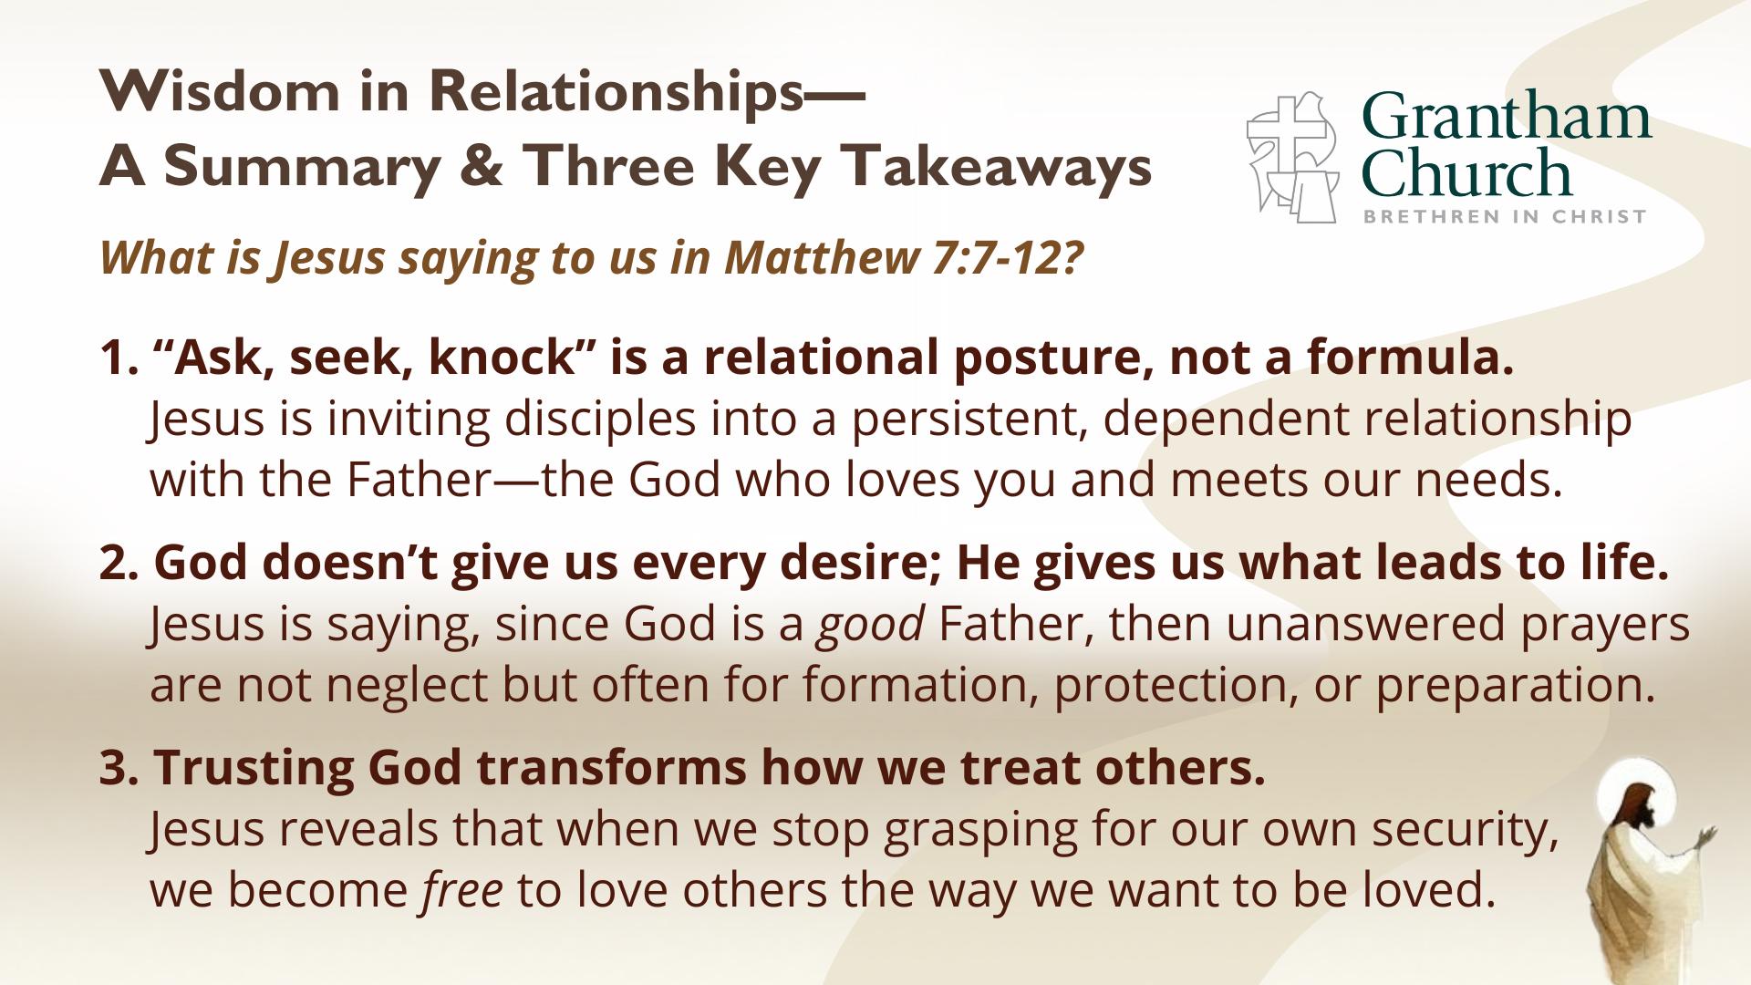
Notes:
1. “Ask, seek, knock” is a relational posture, not a formula. Jesus is inviting disciples into a persistent, dependent relationship with the Father—the God who loves you and meets our needs. Notice, he doesn’t give us a “how to” manual for any and every situation. Rather, he invites us into relationship. He invites us to commune with him through prayer. And while it’s true that sometimes God answers our prayers by changing our circumstances, at other times, as with the man who asked God to change his co-worker, he answers by changing us, so that we can love others well.
2. God doesn’t give us every desire; He gives us what leads to life. Jesus is saying, since God is a good Father, then unanswered prayers are not neglect but often for formation, protection, or preparation. We can be assured that our prayers are heard. [READ ”IMAGINE THE GOD OF HEAVEN” PGS. 213-214]
3. Trusting God transforms how we treat others. Jesus reveals that when we stop grasping for our own security, we become free to love others the way we want to be loved. Folks, when we realize that God is a good Father, that his Kingdom is coming, and that he promises to right all wrongs and bring about his good future, we can trust him. And it frees us to love others.
We don’t have time to read it this morning, so, I want to give you some homework… [NEXT SLIDE]

Slide 14
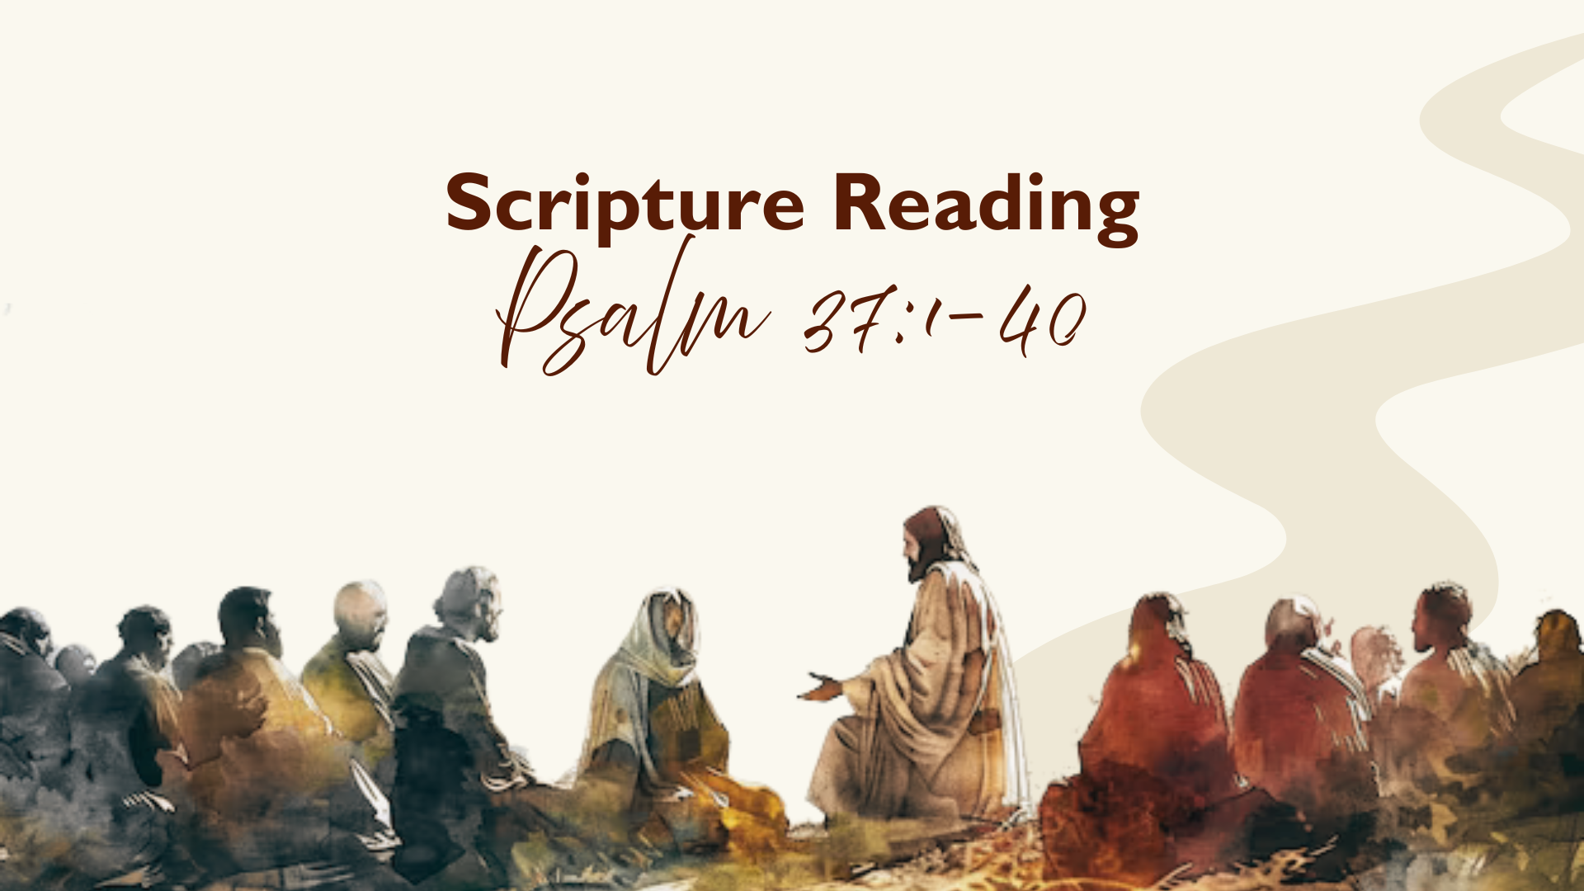
Notes:
[BRIEF COMMENTS]
A passage that speaks to our feelings in the current moment
Finally, here are some questions to help us reflect on what we’ve heard and respond to the promptings of the Spirit… [NEXT SLIDE]

Slide 15
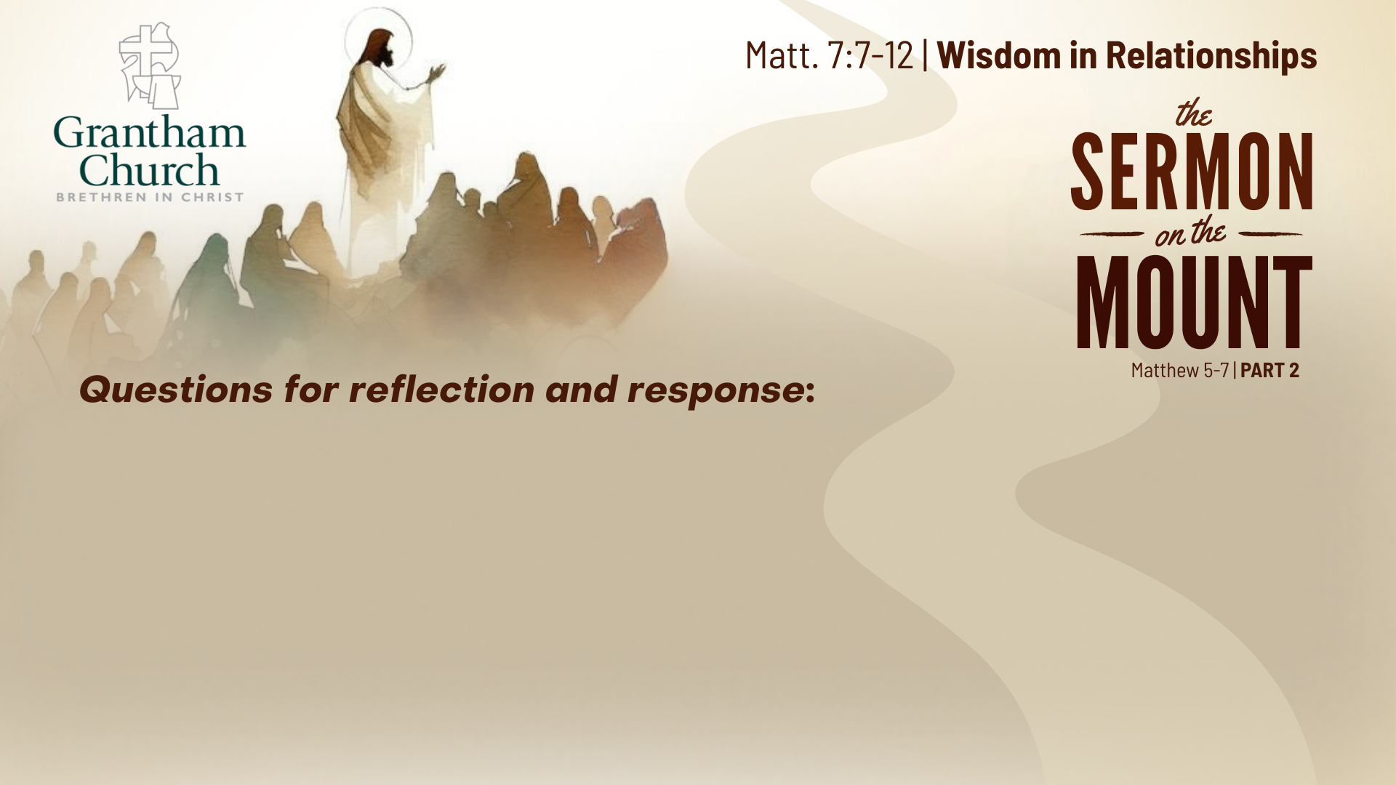

Slide 16
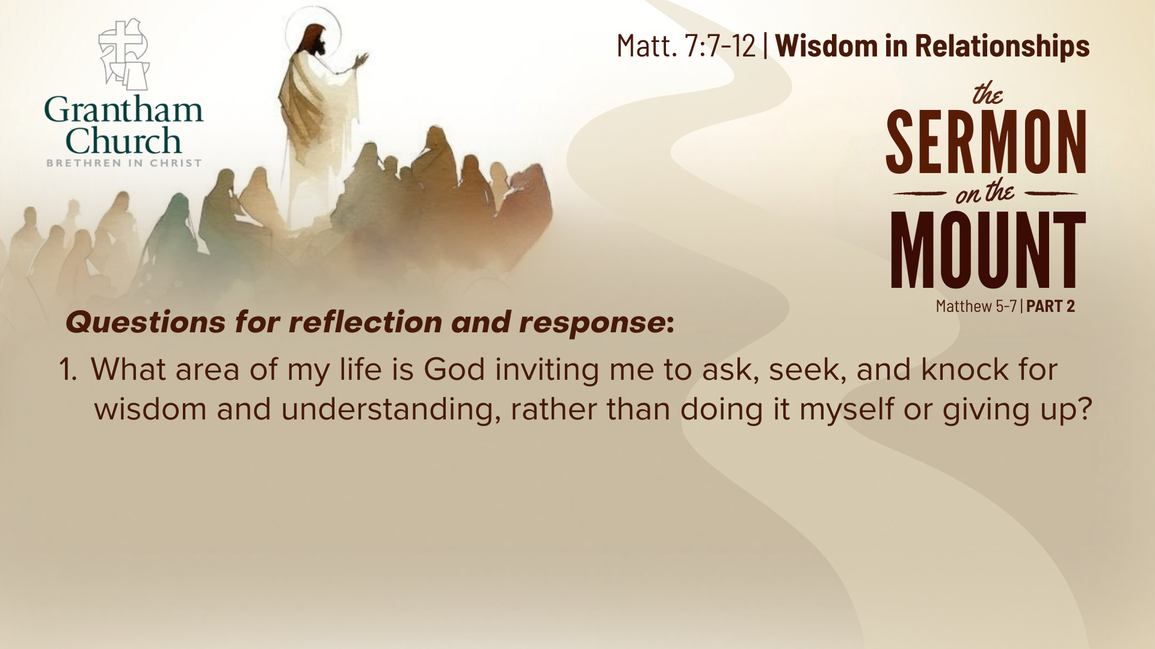

Slide 17
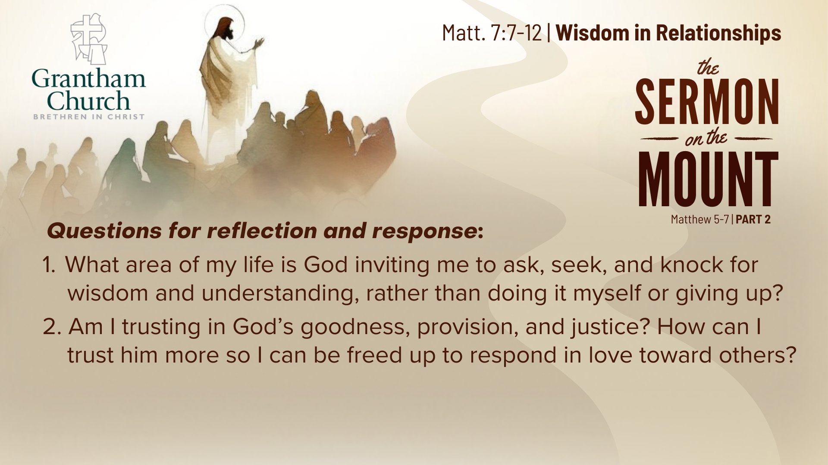

Slide 18

Notes:
[READ EACH QUESTION & COMMENT]
What area of my life is God inviting me to ask, seek, and knock for wisdom and understanding, rather than doing it myself or giving up?
Am I trusting in God’s goodness, provision, and justice? How can I trust him more so I can be freed up to respond in love toward others?
How is the Spirit inviting me to experience more peace, grace, and love in my life by accepting the wisdom and ways of Jesus?
Pray with me… [NEXT SLIDE]

Slide 19

Notes:
[CLOSING PRAYER]
[APOSTLES’ CREED]
[COMMUNION]
Benediction
Brothers and sisters, you have heard the words of Jesus and the call to follow him. The path is narrow, but it leads to life. Remember that Christ walks with you, the Father surrounds you, and the Spirit empowers you. Therefore, go in peace, to love and serve the Lord. Amen.

